Slide 1
19BIO211 Intelligence for Biological System 4 RNA folding problem End Semester Project BY Rahul G – [CB.EN.U4AIE20056]

Slide 2
Contents
Introduction
Why ILP?
Prerequisites
ILP formulation
Constraints
Example

Slide 3
Introduction
Nucleic acid secondary structure is the represented as a list of bases which are paired in a nucleic acid molecule.

Slide 4
Introduction
Biological RNA is single stranded and often forms complex and intricate base-pairing.
Due to interactions due to its increased ability to form hydrogen bonds stemming from the extra hydroxyl group in the ribose sugar.

Slide 5
Why ILP?
Aim : To predict the secondary structure of an RNA molecule, given only its nucleotide sequence.
Usually modelled in Dynamic Programming
Integer Linear Programming requires much less effort

Slide 6
Prerequisites

Slide 7
Prerequisites – Nucleotide Bases
Each nucleotide consists of a base – A, U, C, G, a phosphate group, and a sugar group.
Through the formation of hydrogen bonds the two groups of complementary bases, A-U and C-G, form stable base pairs.

Slide 8
Prerequisites – Keypoints
Pairing - set of disjoint pairs of characters in s.
A pair that is in a pairing is said to be a matched pair
Complementary pair - characters in the pair are {A,U} or {C,G}.
Nested pairing and fold stability

Slide 9
ILP formulation - Notations
One binary var – P(i,j) – denotes whether or not the nucleotide in position i of s will be paired with the nucleotide in position j of s for each position in s Objective – maximize P(i,j) with constraints

Slide 10

Updating Objective function
The interactions between the pair of nucleotides ‘C’ and ‘G’ is a little more stronger than the interactions between the pair ‘A’ and ‘U’
{C,G} - three hydrogen bonds
{A,U} - two bonds.

Slide 11
Constraints

Slide 12
Constraint - 1
A nucleotide present in RNA sequence can only bond with its complement present in the sequence.
A pairs with U
U pairs with A
C pairs with G
G pairs with C

Slide 13
Constraint - 2
A nucleotide present in RNA sequence can be paired with only one other nucleotide present in the sequence.

Slide 14

Constraint - 3
No to pairings or bonds present in an RNA sequence must cross each other, all the interactions must be in a nested manner.

Slide 15
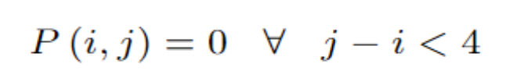
Constraint - 4
A nucleotide present in RNA sequence can interact with another nucleotide which is at least 4 nucleotides away

Slide 16
Example

Slide 17
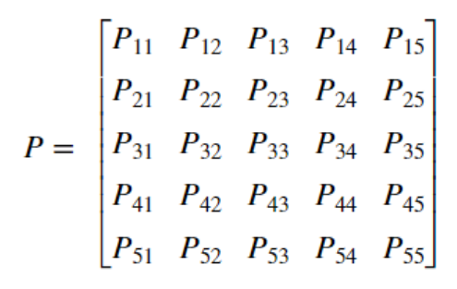
Notations
P(i,j) => matrix
[filled with variables P_{ij} at the position (i,j)]
Seq = ACUGUACUGUACUGUAC

Slide 18
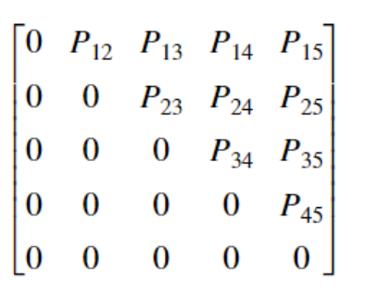
Removing redundant variables

Slide 19
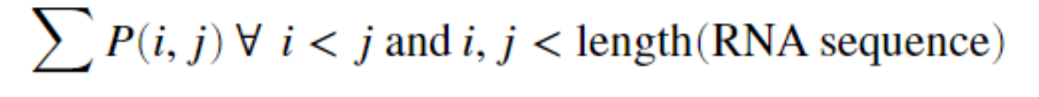
Modelling objective function
The total number of pairings must be maximized in order to keep the RNA molecule compact and stable.

Slide 20
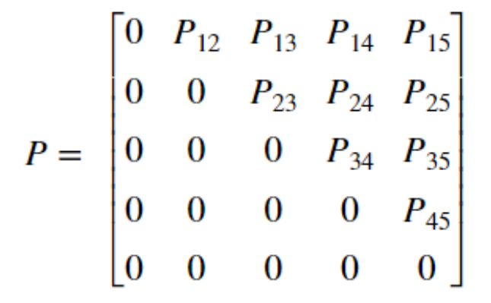

Slide 21
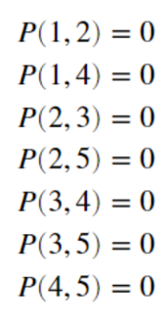

Slide 22
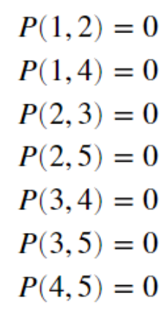
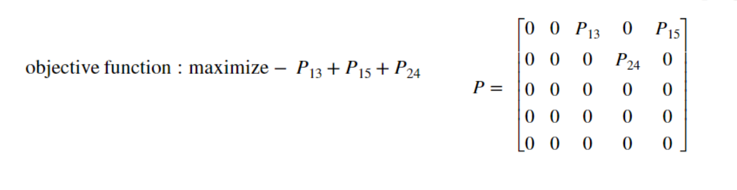
Constraint - 1

Slide 23
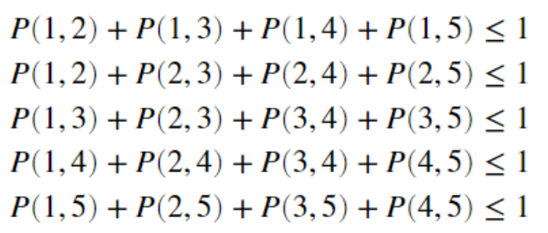
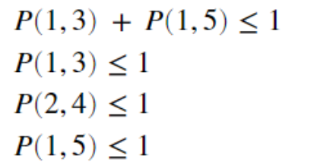

Slide 24
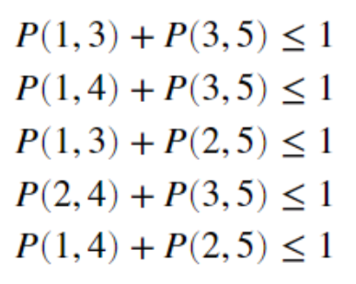
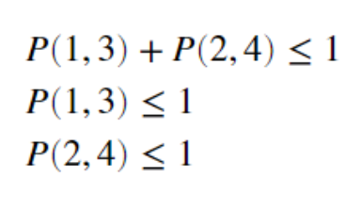

Slide 25

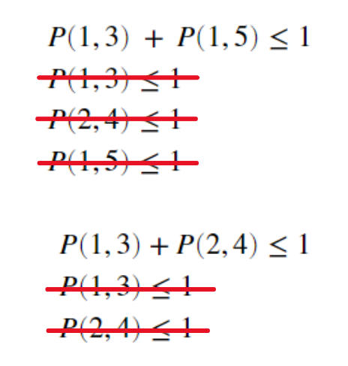
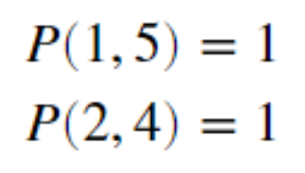

Slide 26
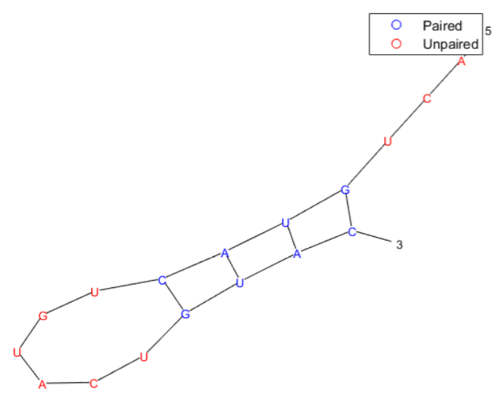
Result
Our Solution
MATLAB solution

Slide 27
Thank You !

